Slide 1


Atliq Hardwares Consumer Goods Ad-Hoc Insights
Presented by
POOJITHA K
SQL PROJECT CHALLENGE

Slide 2
Introduction
Atliq Hardwares (imaginary company) is one of the leading computer hardware producers in India and well expanded in other countries too.
The management noticed that they do not get enough insights to make quick and smart data-informed decisions.
Plan to expand their data analytics team by adding several junior data analysts.
Tony Sharma, the Data Analytics Director, sought to hire a candidate who excels in both technical expertise and soft skills.
There are 10 ad hoc requests for which the business needs insights.
Need to run a SQL query to answer these requests.

Slide 3
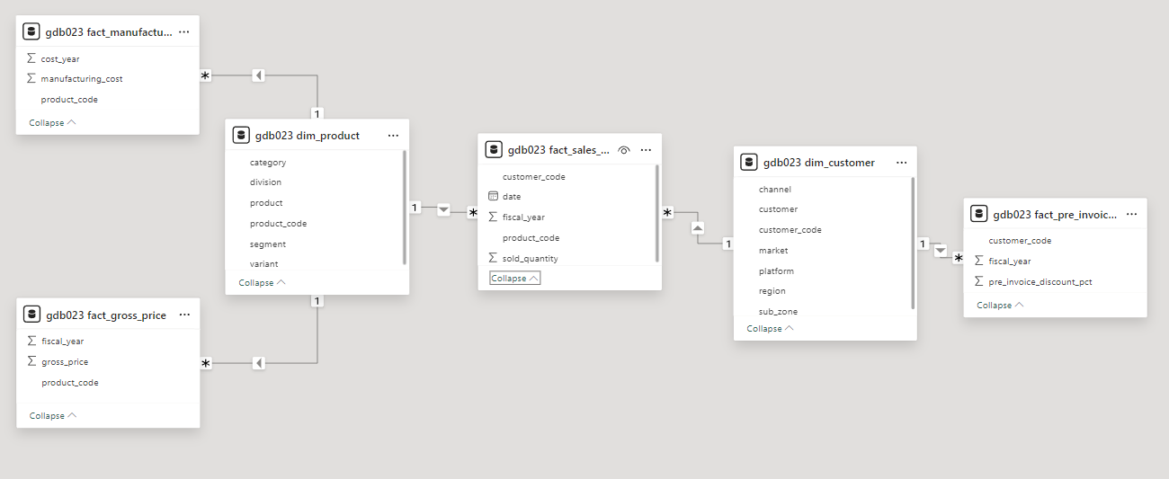
INPUT DATA:

Slide 4
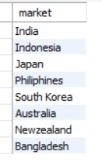

REQUEST-1:
Provide the list of markets in which customer "Atliq Exclusive" operates its business in the APAC region.
OUTPUT:
QUERY :

Slide 5
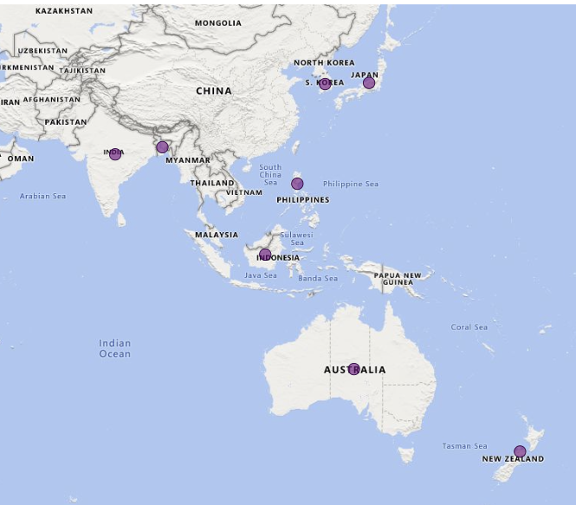
Insights:
"Atliq Exclusive" thrives across diverse markets in the APAC region, showcasing its strategic reach and influence.

Slide 6
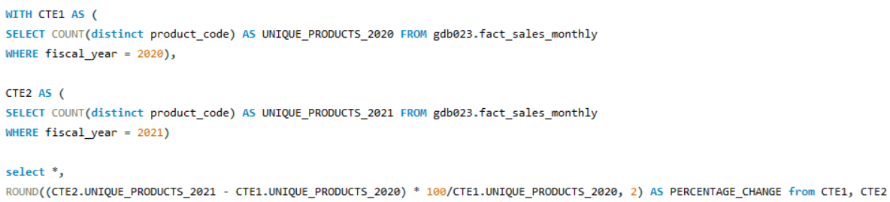
REQUEST-2
What is the percentage of unique product increase in 2021 vs. 2020? The final output contains these fields, unique_products_2020 unique_products_2021 percentage_change
QUERY:

Slide 7
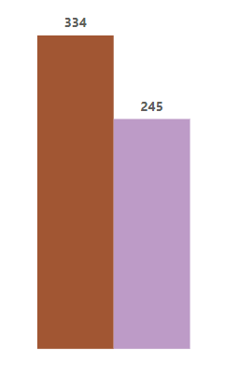

INSIGHTS:
OUTPUT:
PERCENTAGE INCREASE 36.33%
UNIQUE PRODUCT
2021
UNIQUE PRODUCT
2020
2021 vs. 2020

Slide 8

REQUEST-3
Provide a report with all the unique product counts for each segment and sort them in descending order of product counts. The final output contains 2 fields, segment product_count
QUERY:

Slide 9
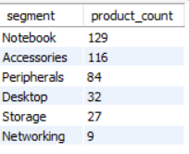
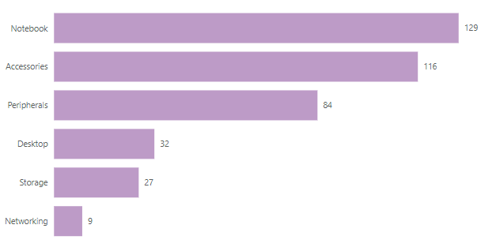

INSIGHTS:
Segments like Notebooks, Accessories, and Peripherals lead with a high variety of products, while Desktop, Storage, and Networking show room for improvement in product diversity.
OUTPUT:

Slide 10
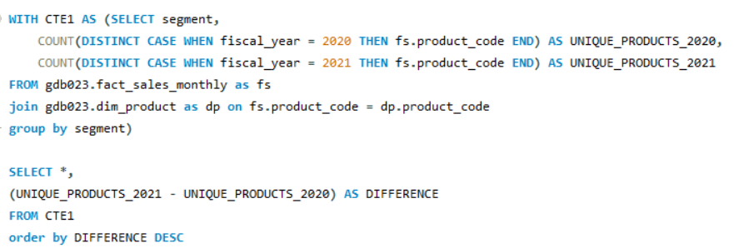
REQUEST-4
Which segment had the most increase in unique products in 2021 vs 2020? The final output contains these fields, segment product_count_2020 product_count_2021 difference
QUERY:

Slide 11

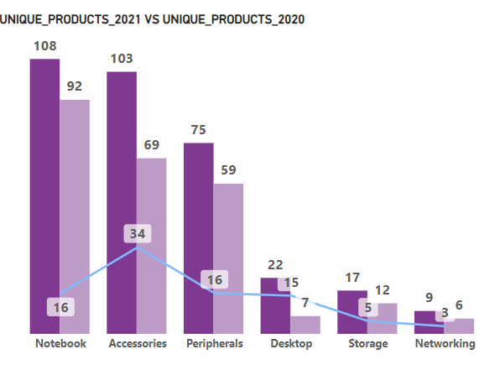
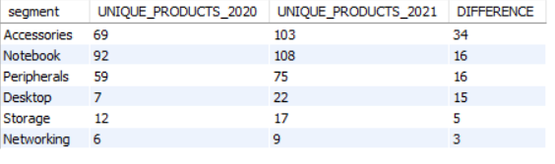
INSIGHTS:
Accessories saw the highest growth in unique products from 2020 to 2021, while Storage and Networking had the least growth.
OUTPUT:

Slide 12
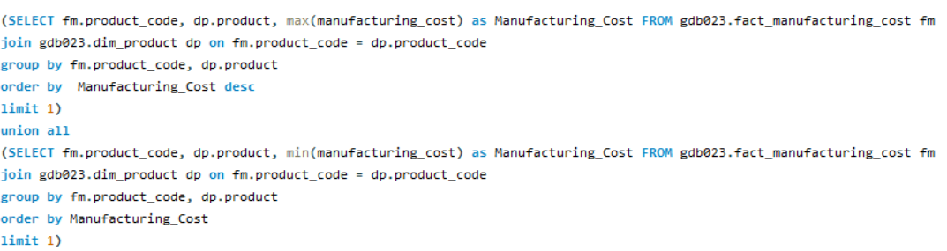
REQUEST-5
Get the products that have the highest and lowest manufacturing costs. The final output should contain these fields, product_code product manufacturing_cost
QUERY:

Slide 13
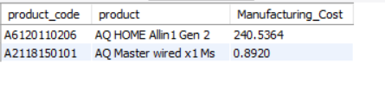
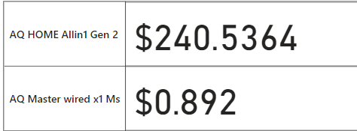
INSIGHTS:
OUTPUT:
The AQ HOME Allin1 Gen 2 (DESKTOP) stands out with the highest manufacturing cost, while the AQ Master Wired (MOUSE) is the most cost-efficient to produce.

Slide 14
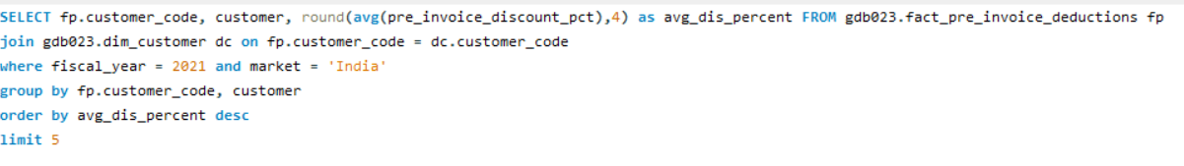
REQUEST-6
Generate a report which contains the top 5 customers who received an average high pre_invoice_discount_pct for the fiscal year 2021 and in the Indian market. The final output contains these fields, customer_code customer average_discount_percentage
QUERY:

Slide 15
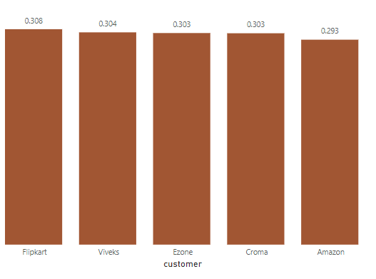
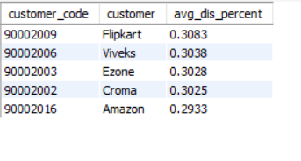
INSIGHTS:
TOP 5 CUSTOMERS have highest average discount percentage for 2021
OUTPUT:

Slide 16
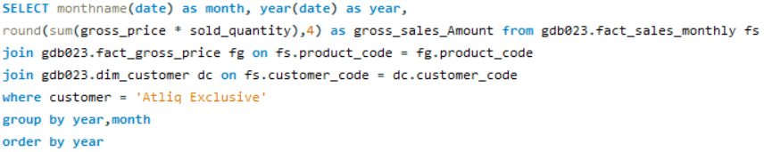
REQUEST-7
Get the complete report of the Gross sales amount for the customer “Atliq Exclusive” for each month . This analysis helps to get an idea of low and high-performing months and take strategic decisions. The final report contains these columns: Month Year Gross sales Amount
QUERY:

Slide 17
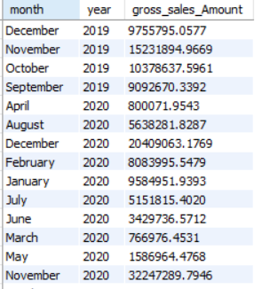
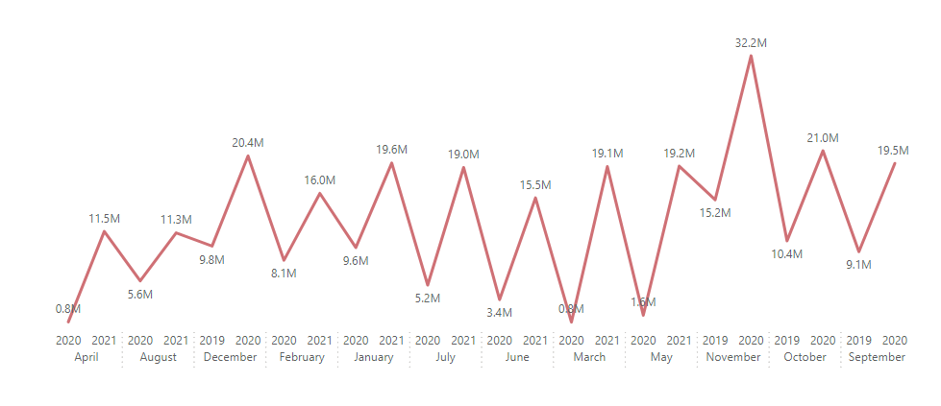
INSIGHTS:
Compared to 2019, the decline in 2020 for "Atliq Exclusive" was mainly due to the impact of COVID-19, supply chain disruptions, and seasonal fluctuations, resulting in lower sales, with a significant increase in sales observed in September 2019.
OUTPUT:

Slide 18
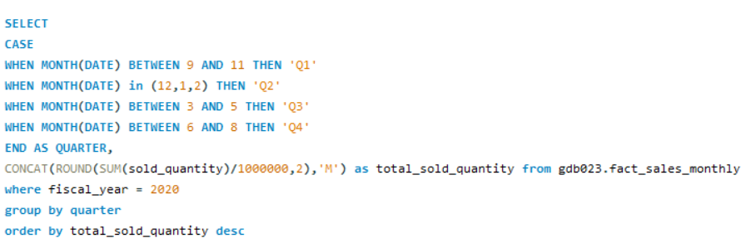
REQUEST-8
In which quarter of 2020, got the maximum total_sold_quantity? The final output contains these fields sorted by the total_sold_quantity, Quarter total_sold_quantity
QUERY:

Slide 19
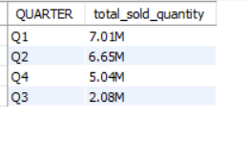
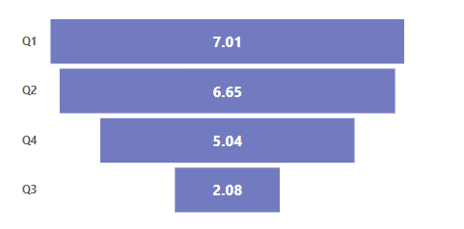
INSIGHTS:
The analysis of total sold quantity by quarter in 2020 highlights high sales from September to February, with a drop in sales from March to May, primarily due to the impact of COVID-19, providing insights for better inventory and sales strategy planning.
OUTPUT:
IN MILLIONS

Slide 20
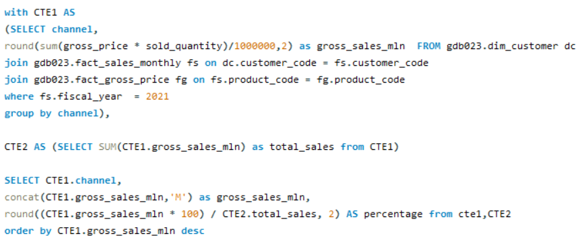
REQUEST-9
Which channel helped to bring more gross sales in the fiscal year 2021 and the percentage of contribution? The final output contains these fields, channel gross_sales_mln percentage
QUERY:

Slide 21
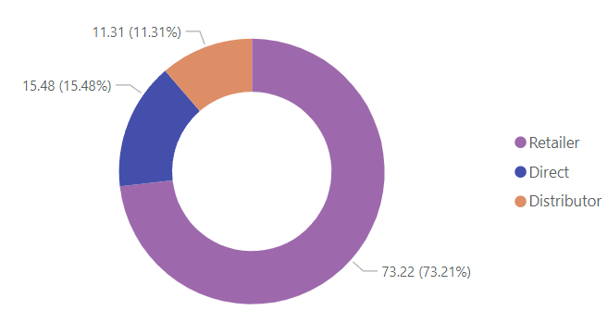
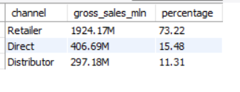
INSIGHTS:
In the fiscal year 2021, the Retailer channel generated the highest gross sales, contributing the largest percentage to overall sales.
OUTPUT:

Slide 22
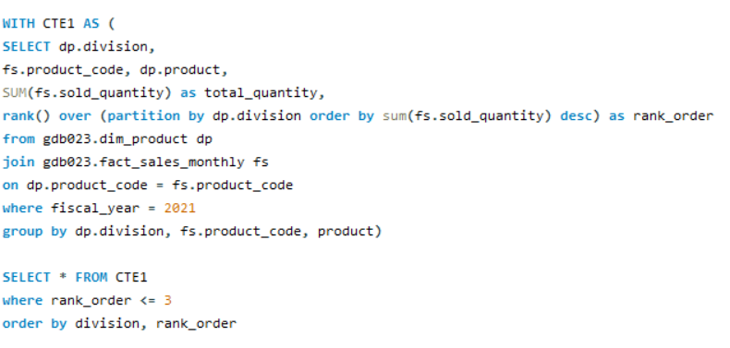
REQUEST-10
Get the Top 3 products in each division that have a high total_sold_quantity in the fiscal_year 2021? The final output contains these fields, division product_code
QUERY:

Slide 23
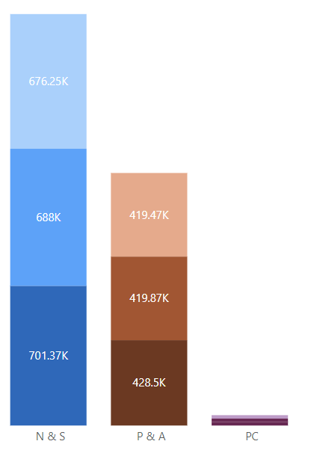
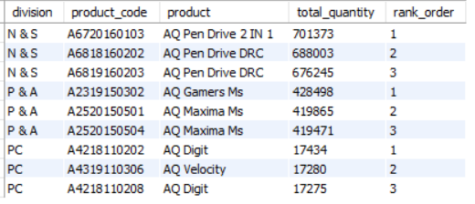
INSIGHTS:
The product "Pen Drive" dominated total sold quantity within the N & S division in 2021, securing the top rank. Other divisions showcased their best-performing products, while the P & C division had comparatively lower sales.
OUTPUT:

Slide 24

Summary
Investigate the low sales in the P & C division to identify potential issues, such as product availability, pricing, or lack of targeted promotions, and address them with strategic interventions
Given the popularity of products like "Pen Drive," consider expanding their availability to other divisions or introducing complementary products to capitalize on their demand.
Use data on high and low-performing months to optimize inventory and launch targeted campaigns during peak sales periods, such as September to February.
Strengthen the Retailer channel’s effectiveness through enhanced support and promotions while exploring opportunities to improve sales performance in other channels like Direct and Distributor.
Monitor evolving consumer preferences across divisions and channels to adjust product portfolios and marketing strategies dynamically.

Slide 25


Thank you

